Slide 1
Customer Personality Analysis
Term Project
COSC621
Abdulla Nabeel

Slide 2
Problem Statement

Slide 3
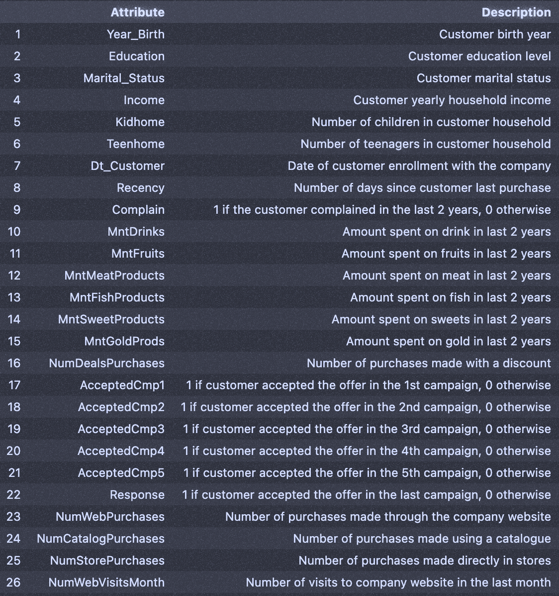
Summarize customer segments by performing clustering
Information
Data consists of 29 attributes with 2240 samples (customers)

Slide 4
Project Pipeline
Data Cleaning
Data Analysis
Missing Values.
Duplicates.
Categorical Attributes.
Feature Engineering.
Outliers
Explore customer characteristics and spendings.
Explore products.
Explore marketing strategies.
Data Preprocessing
Modeling and Profiling
Drop Unnecessary features.
Feature scaling.
Feature selection.
Try multiple clustering algorithms.
Choose the best model.
Profiling and recommendation

Slide 5
Data Cleaning
Data Cleaning
Missing Values.
Duplicates.
Handling Categorical Attributes.
Feature Engineering.
Handling Outliers

Slide 6
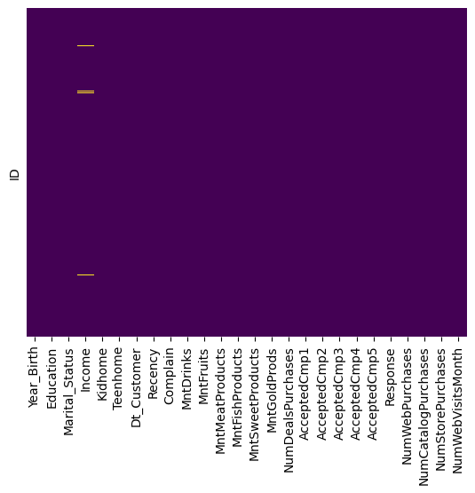
Missing data
24
24
100%
Income

Slide 7
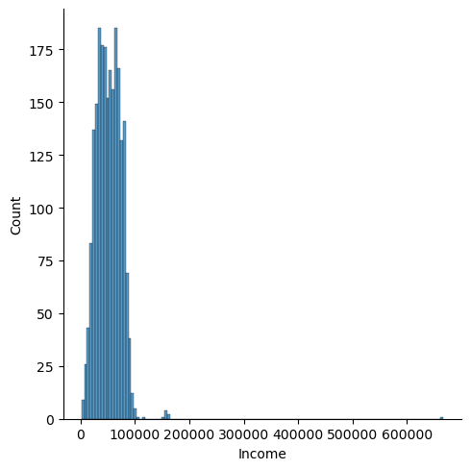
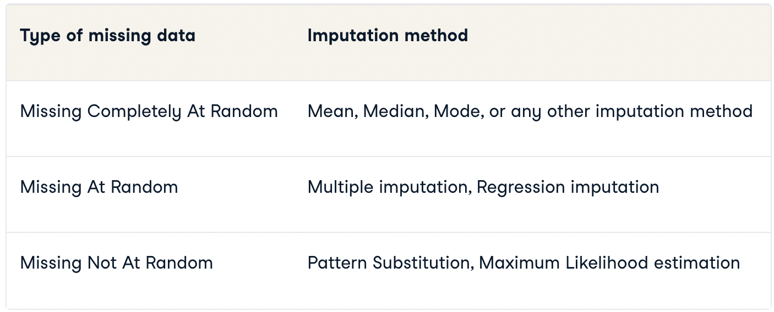
Type of missing data
Income missing data type: Missing at Random.
Income contains outliers, so we need to choose a model that does not get affected by outliers.
Using Gradiant Boosting Regressor (Decision trees as the base estimator)
P(Missing | Complete Data)
=
P(Missing | Observed Data)
outlier

Slide 8
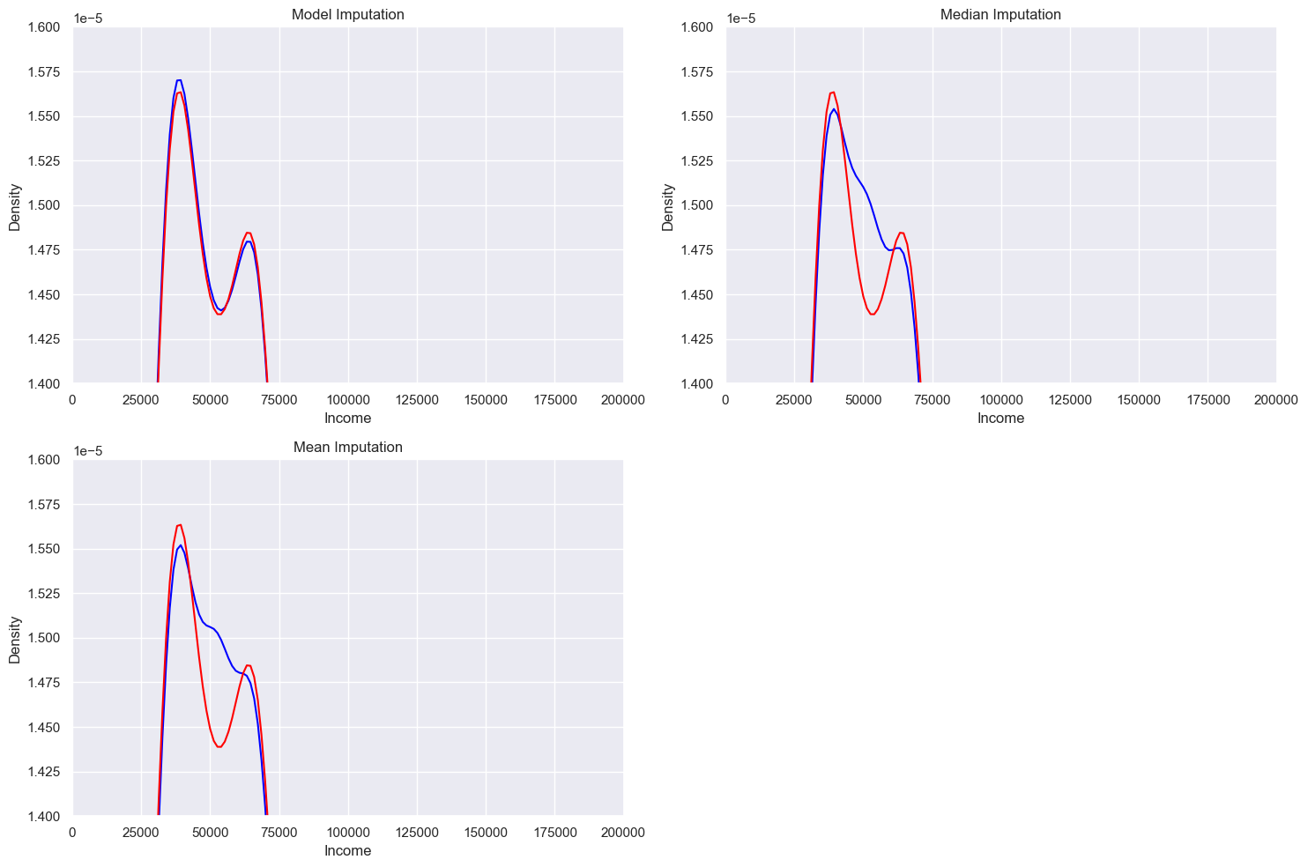
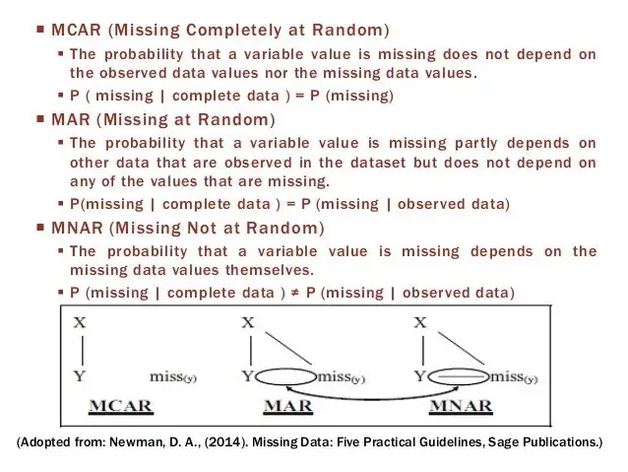
Imputation using Supervised Learning

Slide 9
Duplicates
24
182
100%
Dropping 182 duplicates

Slide 10
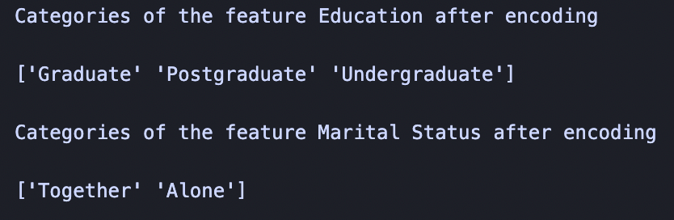
Handeling Categorical Attributes
encoded_education = {
'Master’: 'Postgraduate',
'PhD’: 'Postgraduate',
'Graduation': 'Graduate',
'2n Cycle’: 'Postgraduate',
'Basic’: 'Undergraduate'
}
encoded_status = {
'Married’: 'Together',
'Single’: 'Alone',
'Widow’: 'Alone',
'Divorced’: 'Alone',
'Together’: 'Together',
'Alone’: ‘Alone’,
‘YOLO’: ‘Alone’,
‘Absurd’: ‘Alone’
}

Slide 11
Feature Engineering
Days since join

Slide 12
Feature Engineering
Personal Information
Shopping Behavior
Age
Days Join
Parent
Children
Total Members
Total Spent
Total Purchase
Total Accepted Camps
8 new features

Slide 13
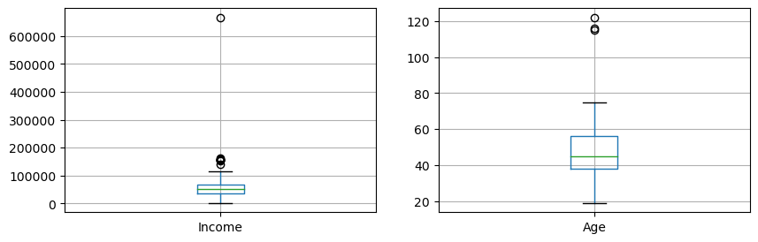
Outliers
filter
filter

Slide 14
Exploratory Data Analysis
Data Analysis
Explore customer characteristics and spendings.
Explore products.
Explore marketing strategies.
The goal is to find some characteristics of customers who spend the most

Slide 15
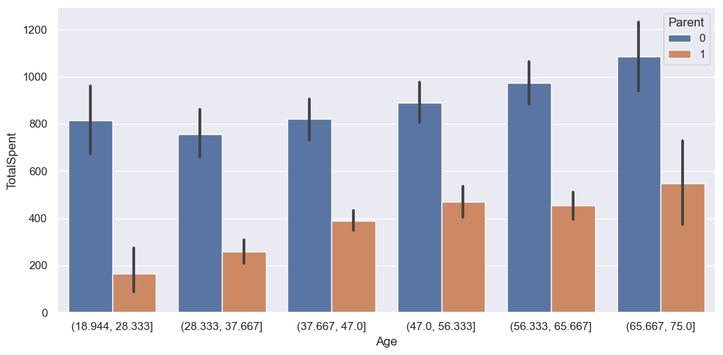
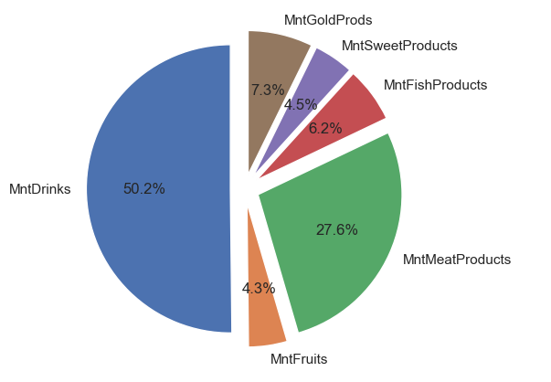
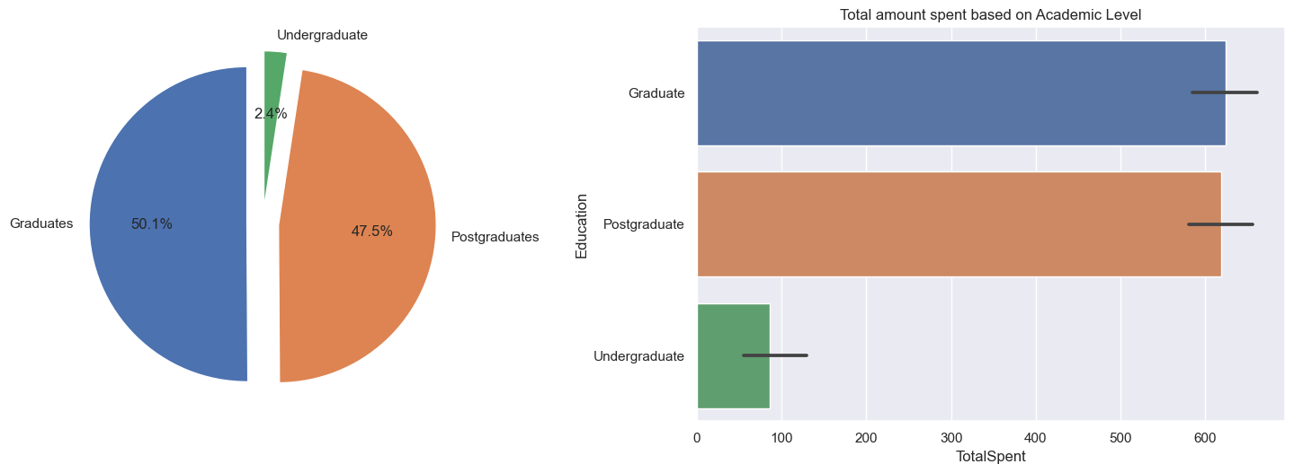
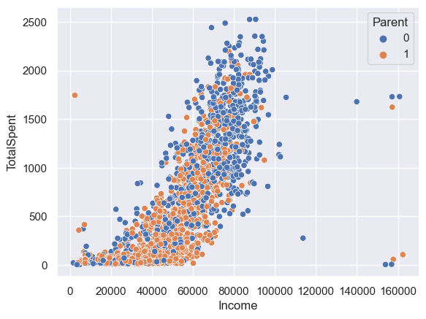
Exploratory Data Analysis I
As Age Increase, Spendings increase.
Most bought products are drinks and meat products.
Spendings increase with income, and those who are not parents tend to spend more.
Graduates and Postgradutes spend the most.

Slide 16
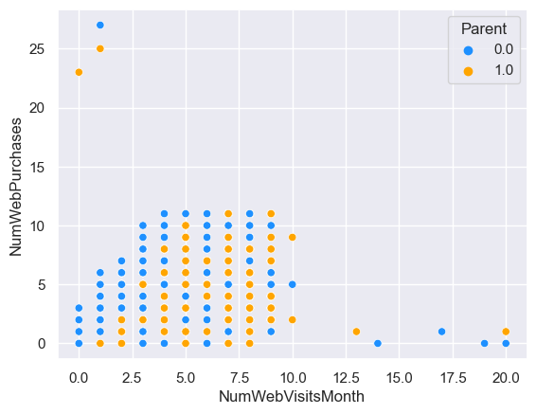
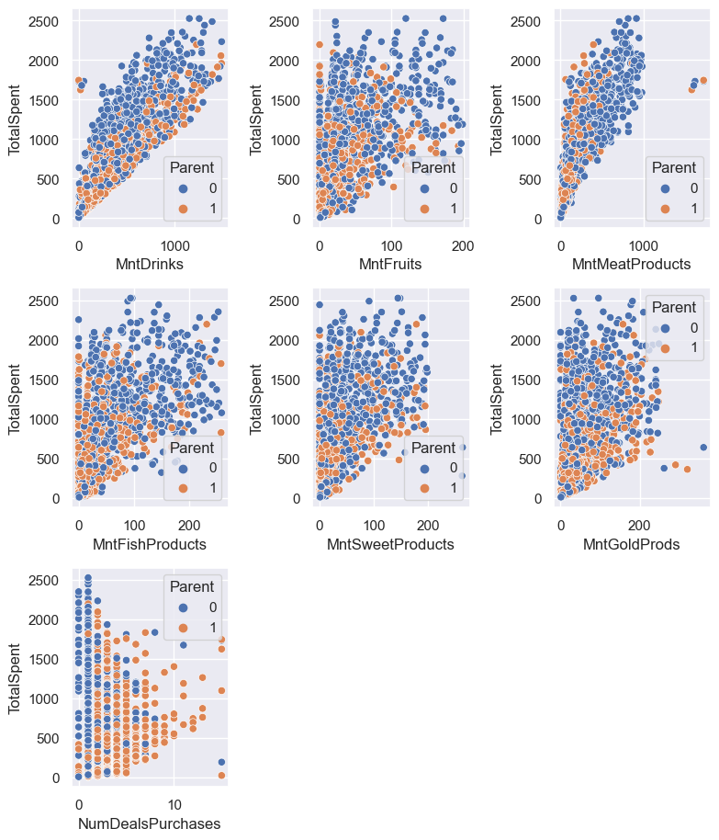
Exploratory Data Analysis II
Deals are exploited mostly by parents. Customers who have high spendings do not have high deal purchases.
There is no correlation between the number of website visits last month and the number of web purchases in total.

Slide 17
EDA closing remarks
Conclusion:
Customers who relatively older, graduated, and have high income tend to spend the most.
Drinks and Meat products generate most of the profit.
The company needs to investigate their marketing strategy on deals as it only draws parents.
For online purchases, we saw that there is no correlation between website visits last month and purchases. Therefore, the company should make daily online deals to attract customers.

Slide 18
Data Preprocessing
Data Preprocessing
Drop Unnecessary features.
Feature scaling.
Feature selection.

Slide 19
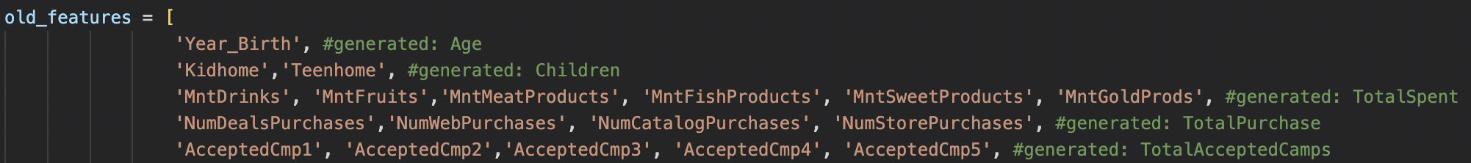
Methodology
We will drop features that were used to generate new, meaningful features.
We will drop features that describes short-term data (NumWebVisitsMonth).
We will drop features with very low variance.
Scale data using Standardization.
Final Features:
['Income', 'Recency', 'DaysJoin', 'TotalSpent', 'Age', 'TotalMembers', 'TotalPurchase']

Slide 20
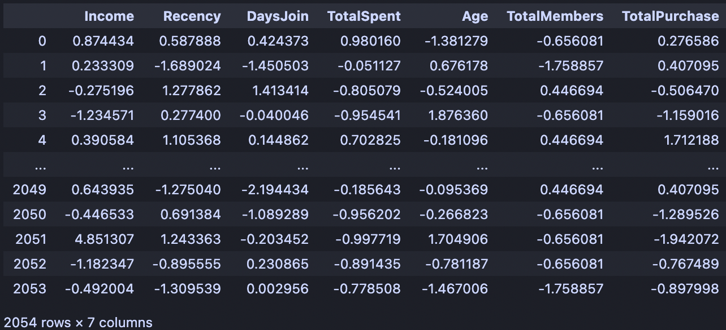
Dataset for modeling

Slide 21
Modeling and Profiling
Modeling and Profiling
Try multiple clustering algorithms.
Choose the best model.
Profiling and recommendation

Slide 22
Unsupervised Learning - Clustering Models
Kmeans
1
Center point is a mean centroid.
Kmedoid
2
Center point is a data point.
Gaussian Mixture
3
Mean vector represent the center point of a cluster in the feature space.
Notes:
Kmeans: Centroid is selected as the arithmetic mean of all data points in a cluster. The algorithm will iteratively minimize the SSD (Sum Squared Distance) between data points and centroid until convergence is reached.
Kmedoid: Centroid is selected as a data of a cluster. The algorithm will iteratively minimize the SOD (Sum of Dissimilarity) between data points and centroid until convergence is reached.
Gmm: Clusters are represented by their mean vector and covariance matrix (which defines it shape). The algorithm iteratively updates the mean vectors and covariance matrices for each cluster until convergence is reached. (Maximizing the probability that a data point will fall inside the cluster whose parameters are defined with its mean and covariance)

Slide 23
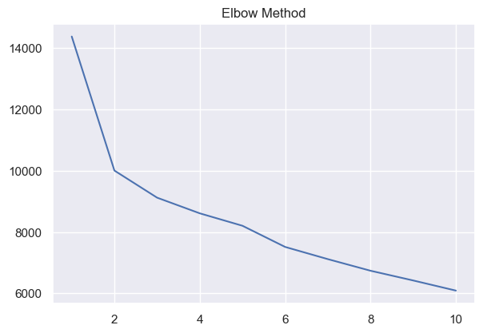
Determine Number of Clusters
Strong elbow at 2
Another elbow at 3
inertia
Number of clusters

Slide 24
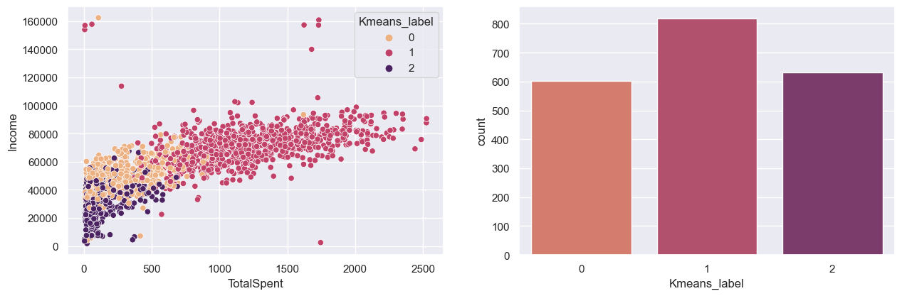
Kmeans results

Slide 25
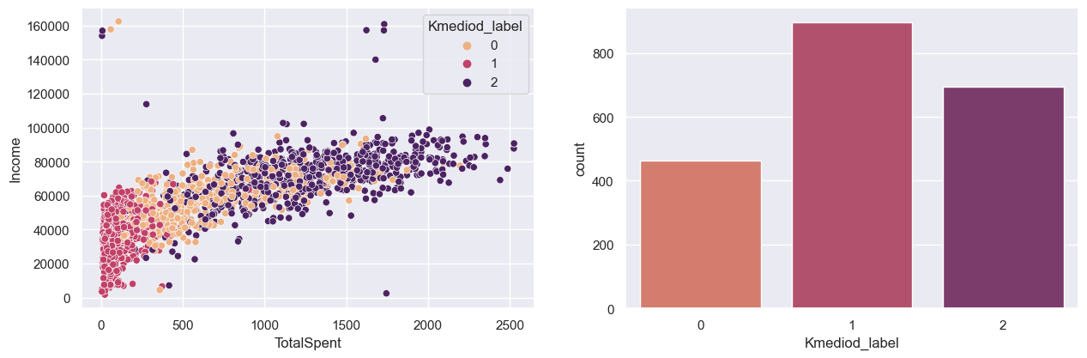
Kmedoid results

Slide 26
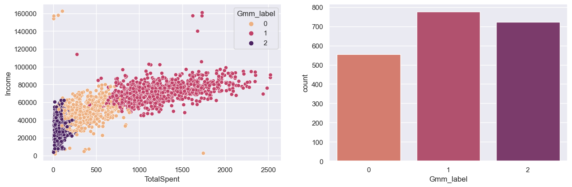
Gaussian Mixture results

Slide 27
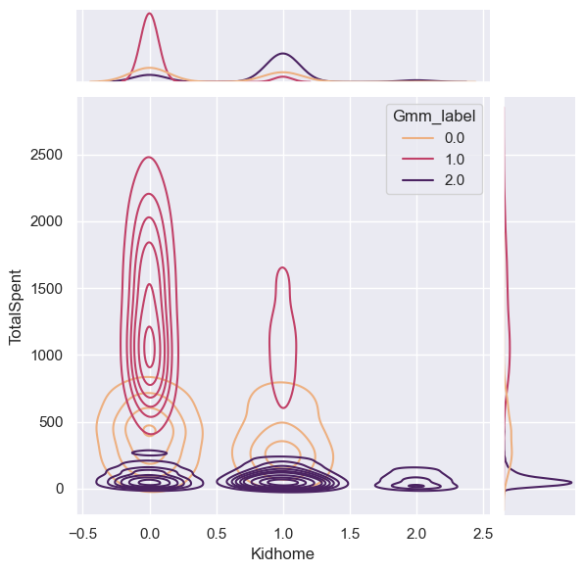
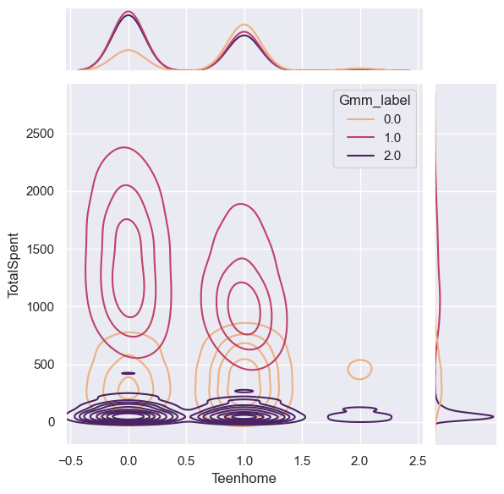
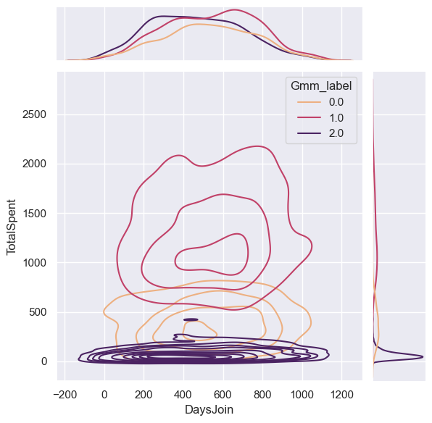
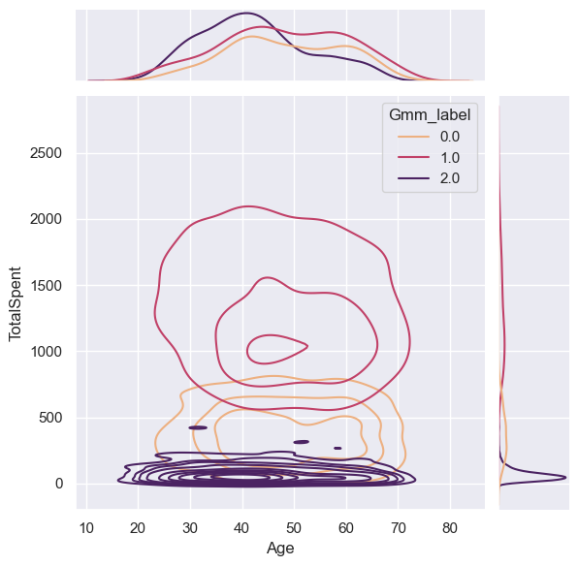
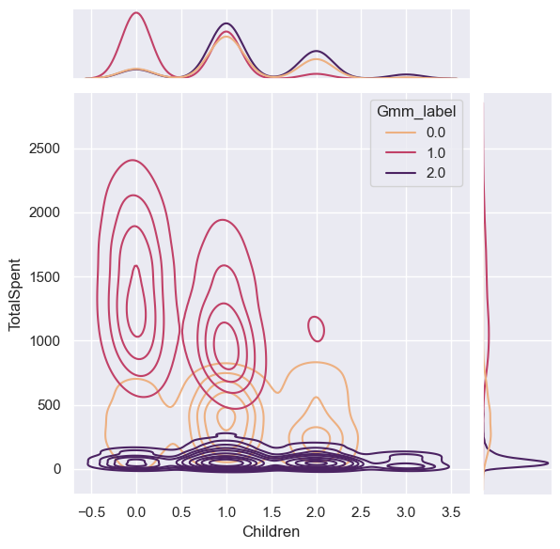
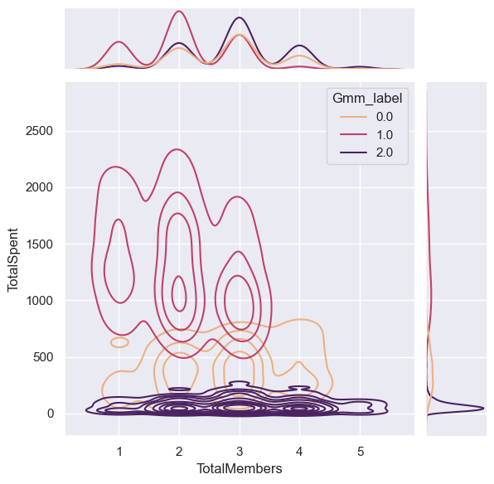

Slide 28
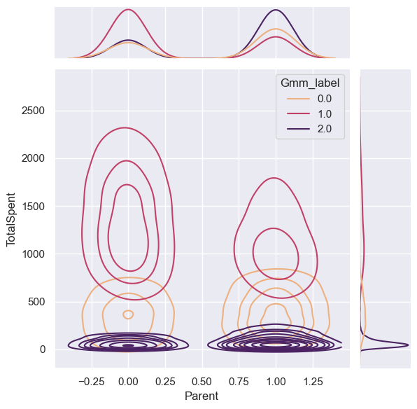
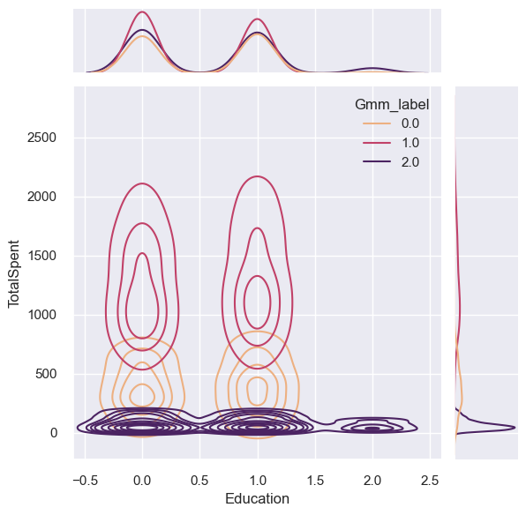
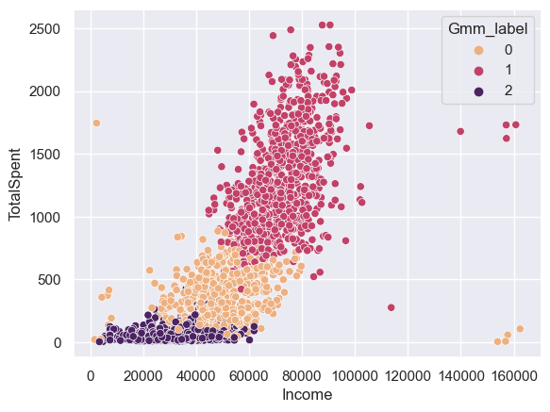
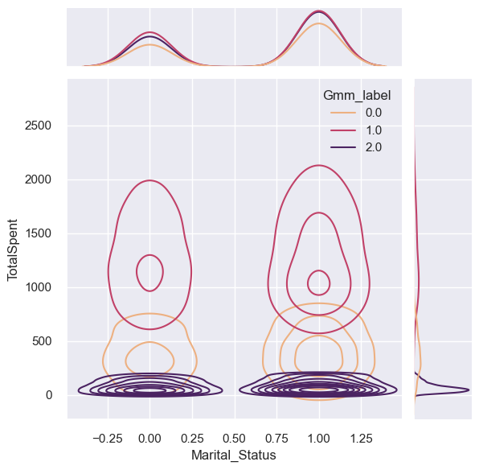

Slide 29
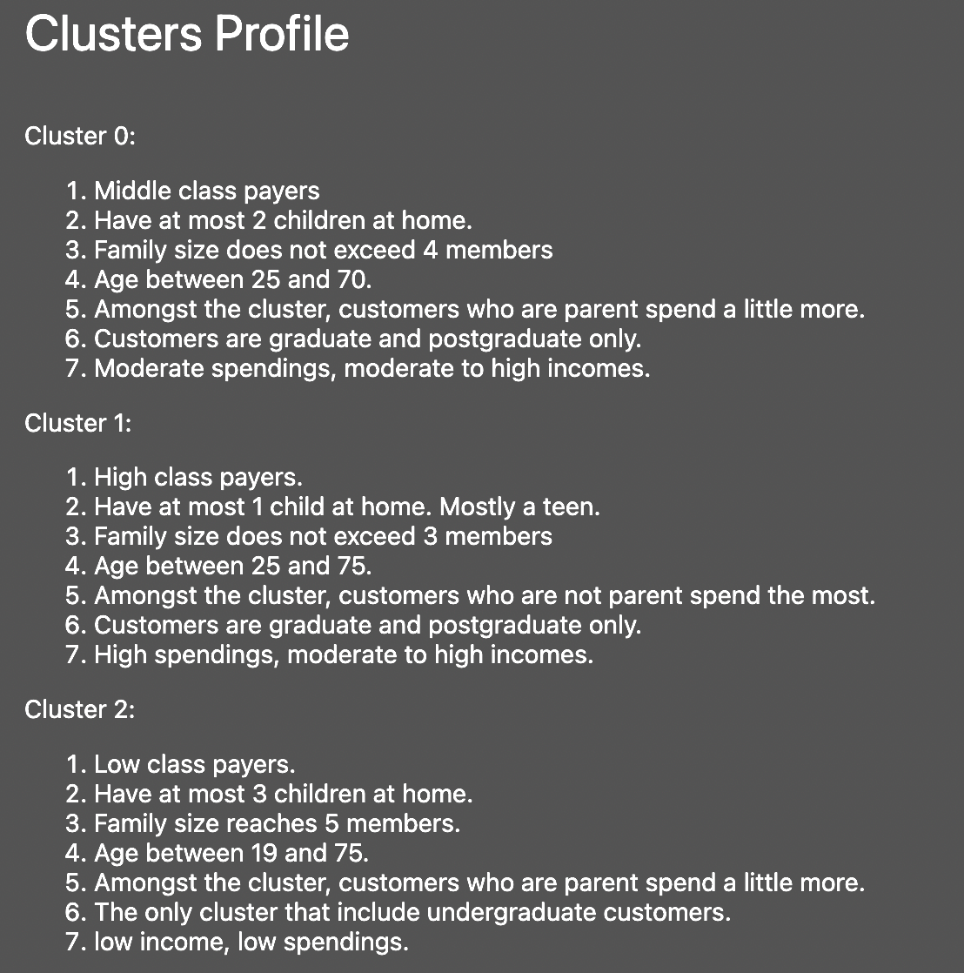
encoded_label = {
0: 'Middel_class',
1: 'High_class',
2: 'Low_class'
}

Slide 30
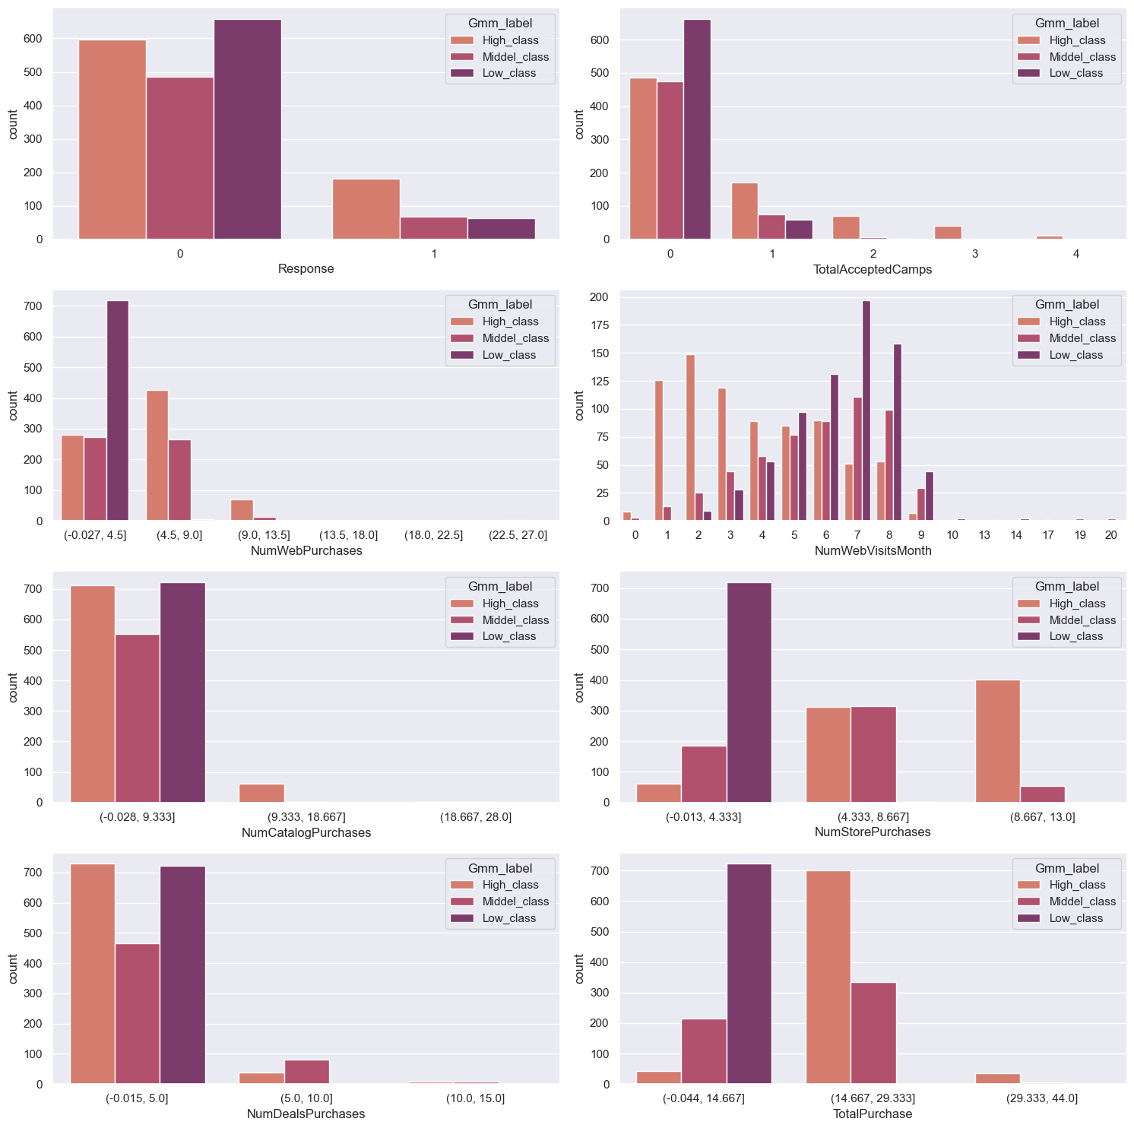
Recommendations
Company's market campaigns are not successful amongst all clusters, even for the last campaign (Response). Company needs to revisit their marketing strategy.
Low class customers visit the website the most last month, yet they make the least website purchase. Company Needs to investigate their online market and make daily online promotions.
Deals are not attracting customers that much, especially low-class customers. Company needs to put more deals because the low-class cluster is the second biggest cluster.

Slide 31
Thank you

